Slide 1
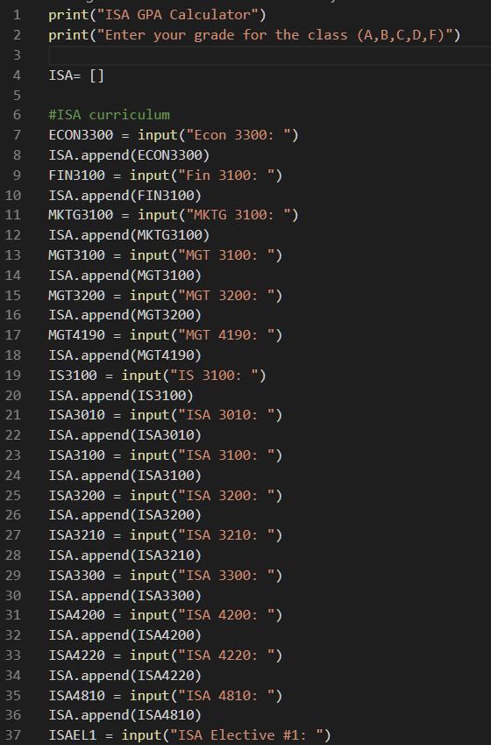

ISA GPA Calculator
ISA GPA calculator is a script that takes ISA class grades and returns a grade point average for the career path.
Coded by Luis Gonzalez, based on work by jShiohaha

